Slide 1
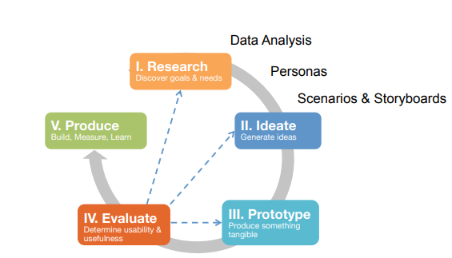
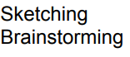
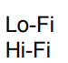
Design Process at a Glance

Slide 2

In order to build a (Low-Fidelity) prototype, we first need some ideas…
Notes:
https://unsplash.com/photos/BoAbPMRKLS0

Slide 3
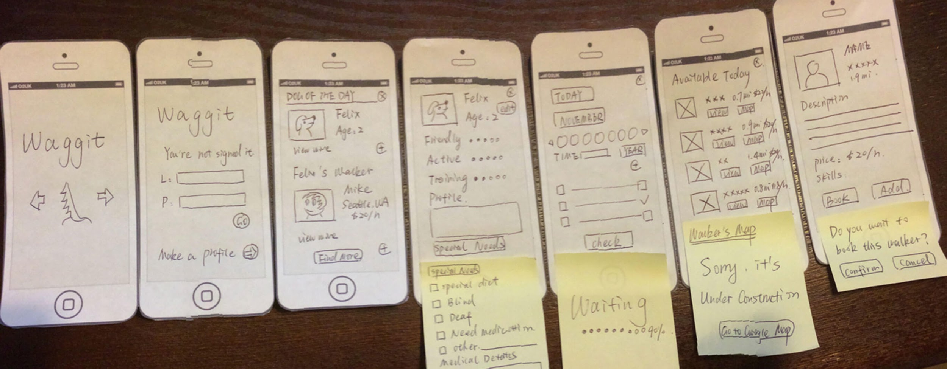
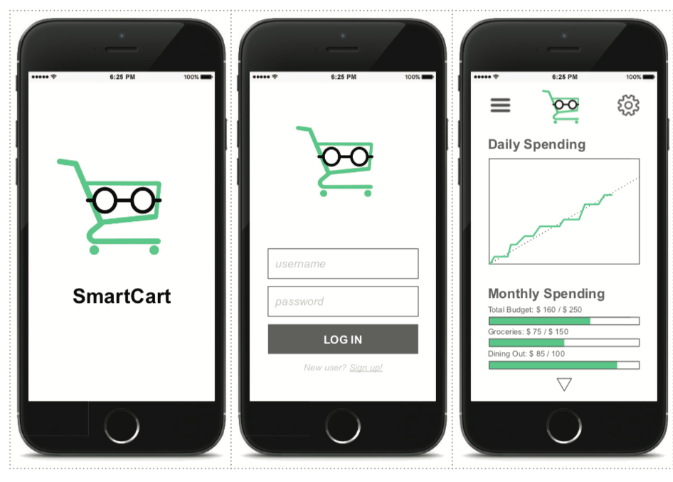
Two Types of Prototypes
Low-Fidelity vs. High Fidelity
Simple screens are drawn on paper, switching the sketches around according to user choices.
Interactive prototype created in FluidUI, mirrored on an iPhone.

Slide 4
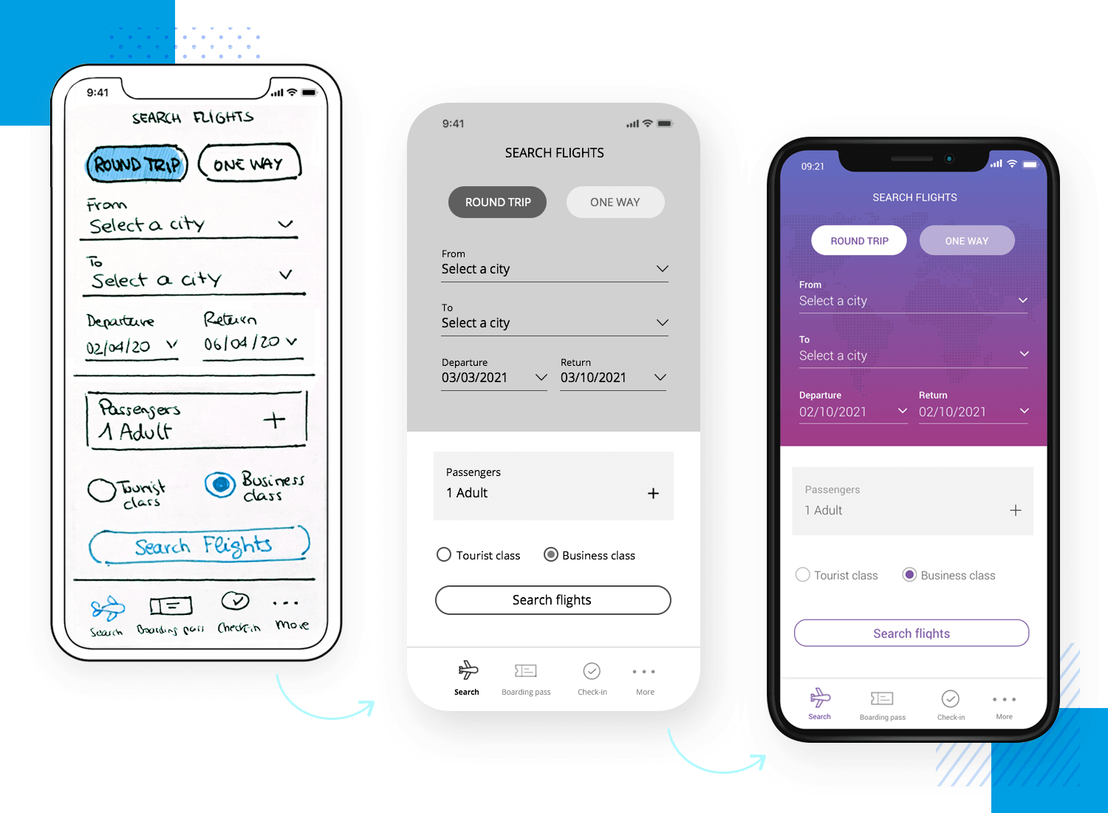

Slide 5
Hi-Fi vs. Lo-Fi
 | Lo-Fi | Hi-Fi
Advantages | Fast Cheap Easy Can simulate actual product | Better sense of finished product Can judge aesthetic appeal More realistic experience Can evaluate experience
Disadvantages | Slow response time Can’t get feedback about aesthetic User may question design quality | User may focus on unnecessary details Takes a lot of time to make Users may lose track of big picture

Slide 6
We stay this week in Low-Fidelity!
Low-Fidelity
Avoid Figma or other digital tools aside of digital pens / drawing solutions.
We want you to:
Explore design ideas
Stay Low-Fidelity
Be scrappy and understand designs might change
Simple screens are drawn on paper, switching the sketches around according to user choices.

Slide 7
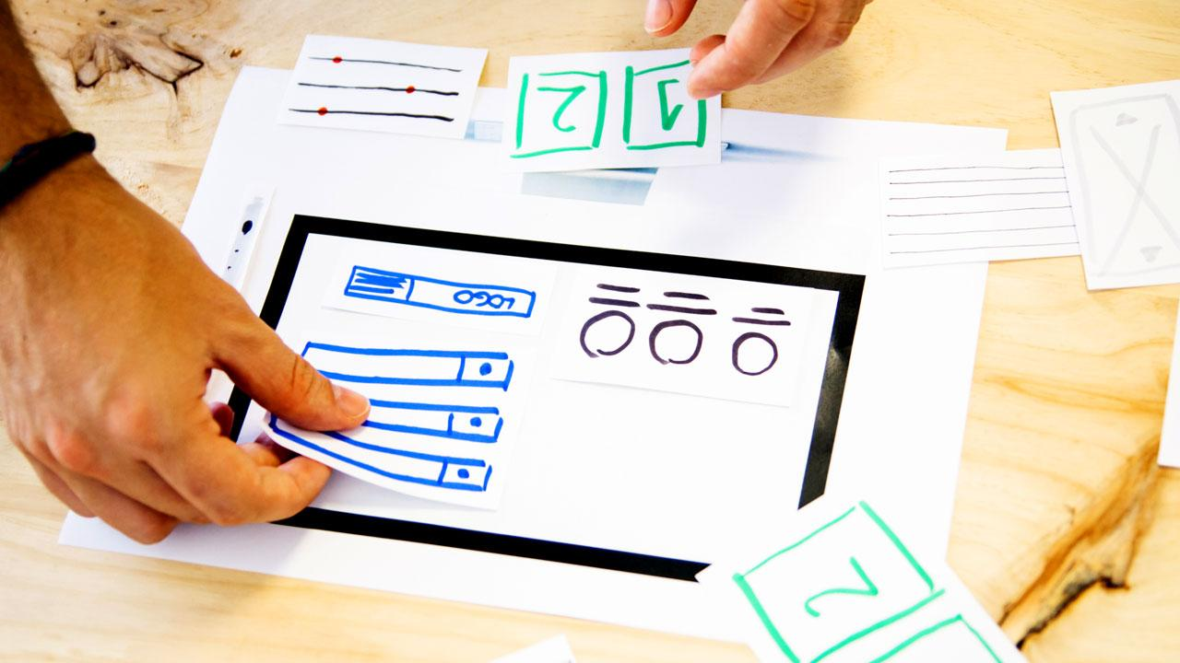
Show, don’t tell - Prototypes build common ground
Memorandum, (2018). Prototyping Digital Exhibits, Part 2. Retrieved from: https://bit.ly/3A0QJMY

Slide 8
Prototypes are a tool to get feedback
Your prototypes
are not valuable,
the feedback
you get from them is.
Notes:
Think about what you are trying to learn with your prototypes, and create objects and scenarios which probe those questions

Slide 9
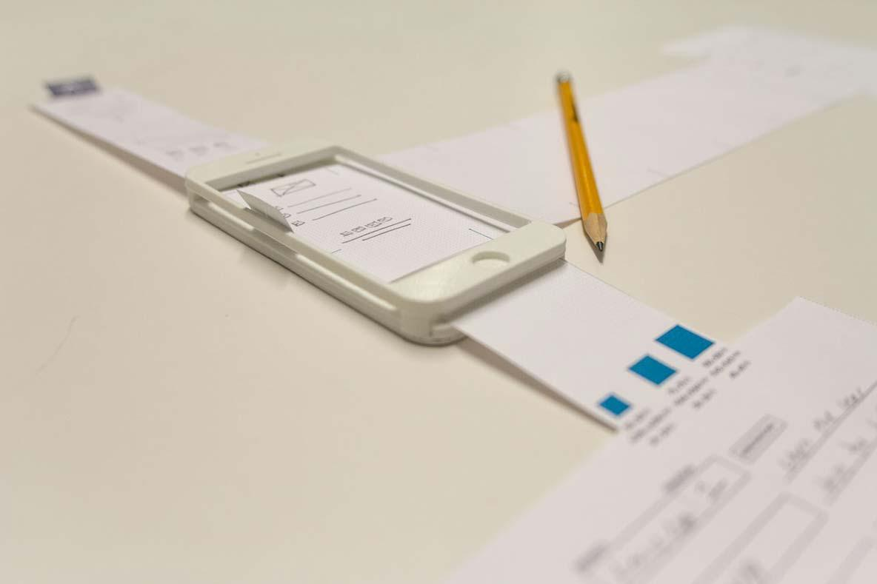
Ways to show Human interaction via Prototypes
Low-fidelity prototyping techniques to show the details of the human interaction:
Paper prototyping
Butler, M. (n.d.). Intro To Paper Prototyping. Retrieved from https://bit.ly/3AbOgQh

Slide 10
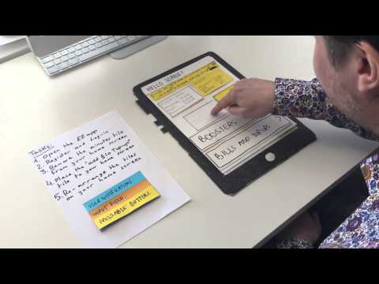
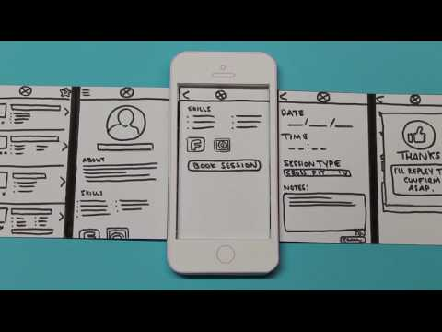
Paper Prototyping [prototyping the human interaction]
Reidy, C. (2017). Mobile Application Design: Paper Prototype Video. Retrieved from https://bit.ly/3a3gSjU
UX Playground (2015). Low fidelity prototype testing of the EE app. Retrieved from https://bit.ly/3FhvGJZ

Slide 11
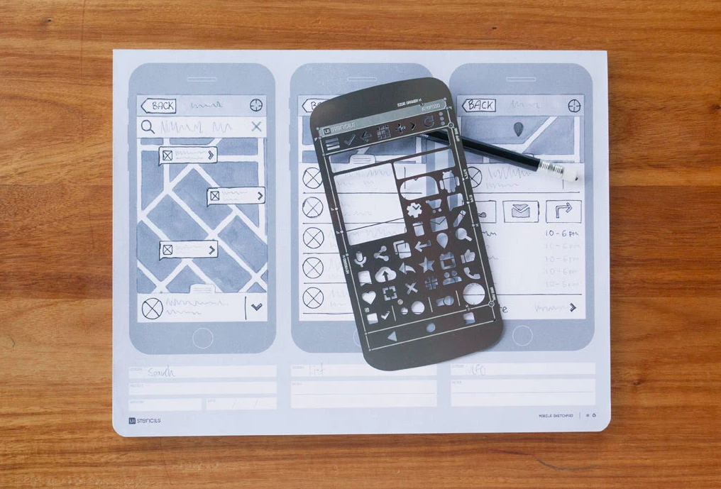
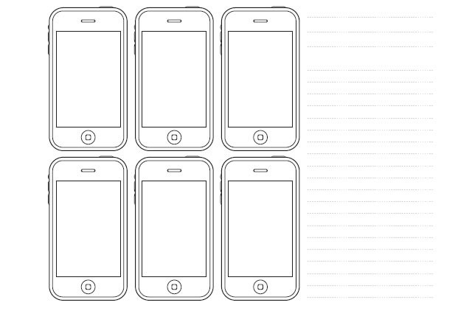
Paper Prototyping [prototyping the human interaction]
Sketching on templates gives prototypes a more professional quality.
Image from UI Stencil, an e-store dedicated to paper prototyping resources: https://www.uistencils.com/
Image from Tripwire magazine that gives 20 free printable sketching and wireframing templates to start from: https://www.tripwiremagazine.com/free-printable-sketching-wireframing-templates/

Slide 12
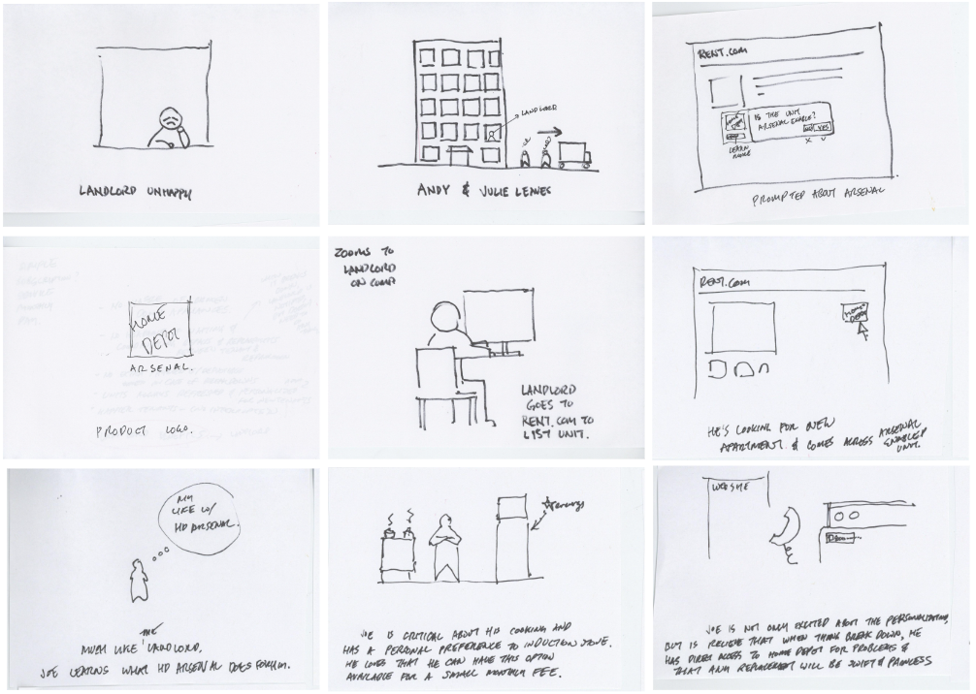
Ways to show the Use Case via prototypes
Low-fidelity prototyping techniques to demonstrate the use case:
Storyboard

Slide 13
Storyboard [prototyping the use case]
Storyboards visualize interactions and flows in context and make them feel more realistic.
Example on the right shows the story of a landlord, who is seeing an ad to prompting him to improve their rental after prior tenants left, while listing his vacant unit.

Slide 14
In review: Low-Fidelity Prototypes
Low-fidelity prototyping techniques to show the details of the human interaction:
Paper prototyping
Low-fidelity prototyping techniques to demonstrate the use case:
Storyboard

Slide 15
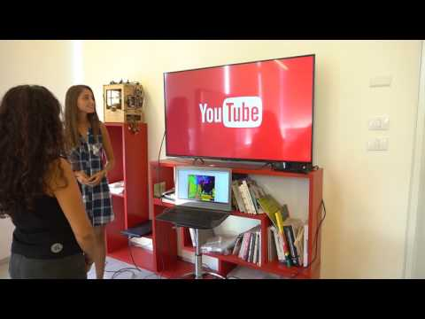
Wizard of Oz [prototyping the human interaction]
Wizard of Oz: A technique for developing prototypes by using everyday objects to represent parts of the finished product.
The Wizard of Oz prototype might perform some – but not all – of the tasks.
In the example on the right,
the prototype supports the visual output and
the human (Wizard of Oz) simulates the feedback of the system after the gestural input.

